Slide 1
Lab 04 - UDP
Sangmyung univ. seoul campus
Human-centered ai(휴먼지능정보공학전공)
201910783
Kim Seong hyun(김성현)

Slide 2
Lab 04: UDP on Wireshark
Instructions
Start capturing packets in Wireshark.
Stop capturing packets.
Questions
Select one UDP packet from your trace. From this packet, determine how many fields there are in the UDP header. Name these fields.
Find out the length (in bytes) of each of the UDP header fields.
The value in the Length field is the length of what? Verify your claim with your captured UDP packet.
What is the maximum number of bytes that can be included in a UDP payload? (Hint: the answer to this question can be determined by your answer to 2. above)
What is the largest possible source port number? (Hint: see the hint in 4.)
What is the protocol number for UDP? Give your answer in both hexadecimal and decimal notation. To answer this question, you’ll need to look into the Protocol field of the IP packet containing this UDP segment.
Examine a pair of UDP packets. (your host sends the first UDP packet and the second UDP packet is a reply to this first UDP packet.) (Hint: for a second packet to be sent in response to a first packet, the sender of the first packet should be the destination of the second packet). Describe the relationship between the port numbers in the two packets.
Notes:
UDP packe을 하나 선택함.(wireshark는 모든 데이터 단위를 packet이라 칭하기에 segment라 안하고 여기서 packe이라고 말한거다.) 선택해서 얼마나 많은 필드들이 존재하는지 확인해보고 이 필드들의 이름을 써보라.

Slide 3
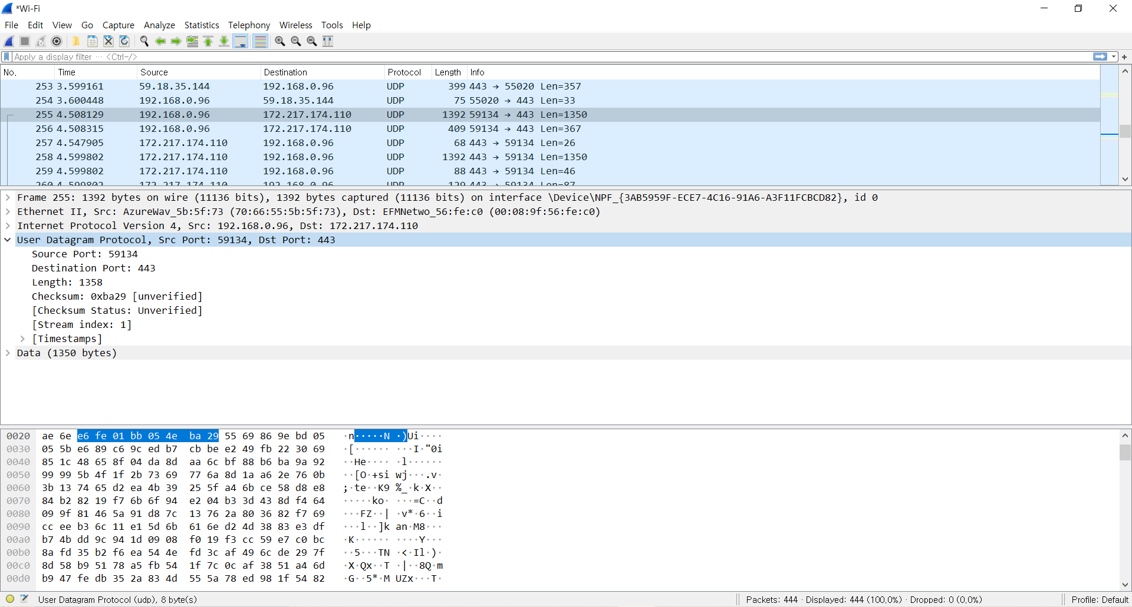
1. Select one UDP packet from your trace. From this packet, determine how many fields there are in the UDP header. Name these fields.
총 4개의 field 존재
( ‘[]’표시는 실제로 packet에 든 data가 아닌 wireshark가 나름대로 분석한 내용임)

Slide 4
1. Select one UDP packet from your trace. From this packet, determine how many fields there are in the UDP header. Name these fields.
<UDP header>
Source port(59134) | Destination port(443) | Length(1358) | Checksum(0xba29)
Fields name
➔Source port(59134)
➔Destination port(443)
➔Length(1358)
➔Checksum(0xba29)

Slide 5
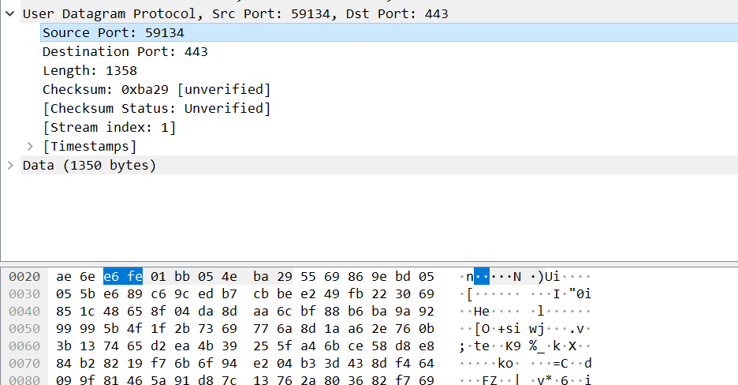
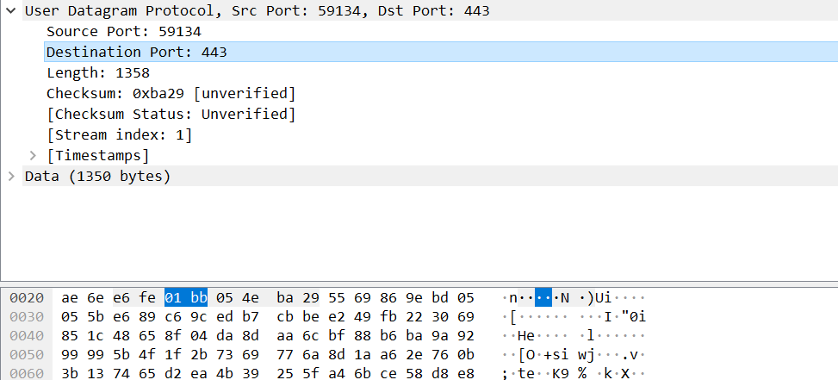
2. Find out the length (in bytes) of each of the UDP header fields
문자2개 붙은 1개 쌍당 1byte
➔source port: 2byte
➔destination port: 2byte

Slide 6
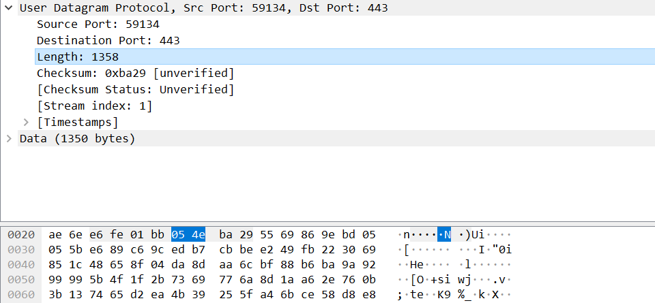
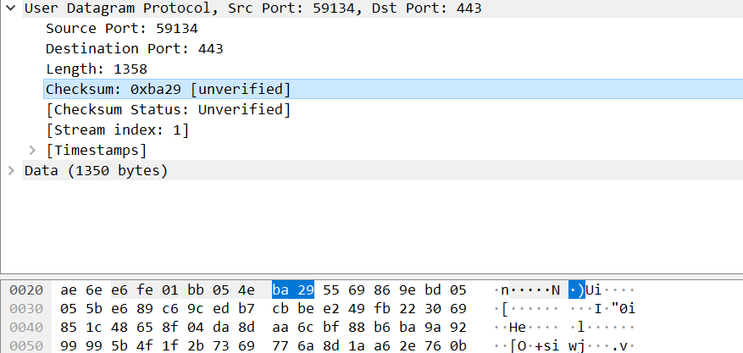
2. Find out the length (in bytes) of each of the UDP header fields
➔length: 2byte
➔checksum: 2byte

Slide 7
2. Find out the length (in bytes) of each of the UDP header fields
<UDP header>
Source port(59134) ➔2byte | Destination port(443) ➔2byte | Length(1358) ➔2byte | Checksum(0xba29) ➔2byte
총 UDP header의 length ➔ 8byte

Slide 8
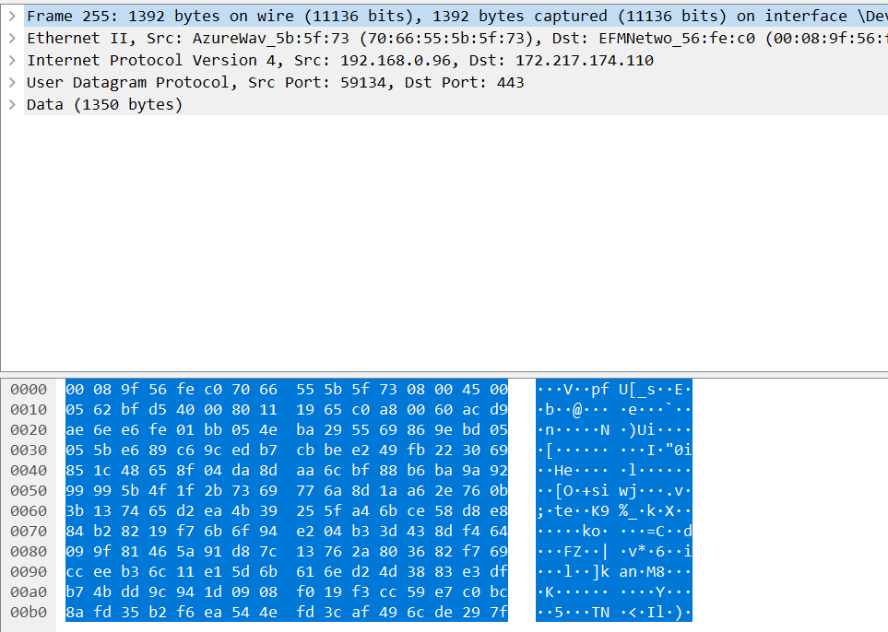
3. The value in the Length field is the length of what? Verify your claim with your captured UDP packet.
➔ 밑으로 엄청~ 길게 이어져 있음
Length’s value: 1358
The value in the Length field is the length of what?
➔UDP header(8 byte) + remaining data bytes(캡쳐된 packet, wireshark에서는 모든 단위를 packet으로 통일해서 보여주기에 여기서도 segmen가 아닌 packe으로 보여주는 것이다)

Slide 9
4. What is the maximum number of bytes that can be included in a UDP payload? (Hint: the answer to this question can be determined by your answer to 2. above)
UDP packet은 2bytes, 즉 16bit의 length field로 우리가 표현하고 상상할 수 있다. (즉 length field가 2bytes, 16bit이고 length field자체가 전체 UDP packet, segment의 크기라서 이렇게 보는 것이다)
그러므로 packet의 최대크기는 2¹⁶ 인 65536에서 1을 뺀 65535bytes이다.
이 때, 8bytes는 이미 UDP header로 사용되고 있다.
그러므로 UDP payload, 즉 UDP의 application data의 최대 크기는 665535에사 UDP header크기인 8ytes를 뺀 65527bytes이다.

Slide 10
5. What is the largest possible source port number? (Hint: see the hint in 4.)
The largest possible source port number is 2¹⁶ – 1 = 65535
UDP packet은 2bytes, 즉 16bit의 Source port number field로 표현 가능
그러므로 표현되는 숫자는 각 byte의 bit당 0, 1의 2가지가 나오고 이게 총 16개가 있으니 2의 16승에 1을 뺀 65535이다.

Slide 11
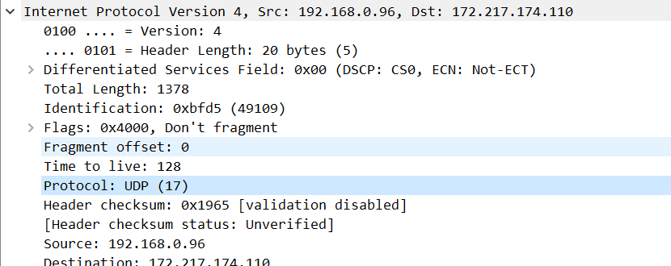
6. What is the protocol number for UDP? Give your answer in both hexadecimal and decimal notation. To answer this question, you’ll need to look into the Protocol field of the IP packet containing this UDP segment.
Protocol number for UDP: 17
➔hexadecimal notation(16진수) = 0x11
➔decimal notation(10진수) = 17

Slide 12
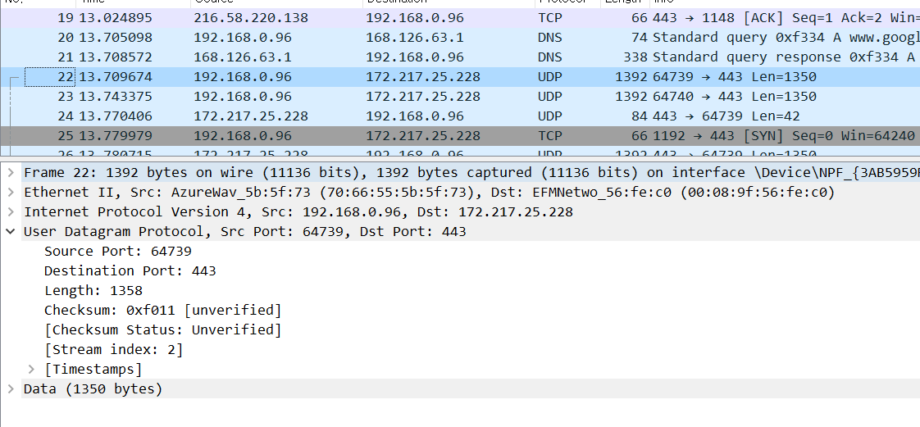
7. Examine a pair of UDP packets. (your host sends the first UDP packet and the second UDP packet is a reply to this first UDP packet.) (Hint: for a second packet to be sent in response to a first packet, the sender of the first packet should be the destination of the second packet). Describe the relationship between the port numbers in the two packets.
(지금까지 봤던 packet이 아닌 서로 pair 표시가 된 UDP packet들을 캡쳐하였음)
First UDP packet(sended packet)
Source port: 64739
Destination port: 443
Pair를 이루는 response인 packet은 135번에 위치했다.

Slide 13
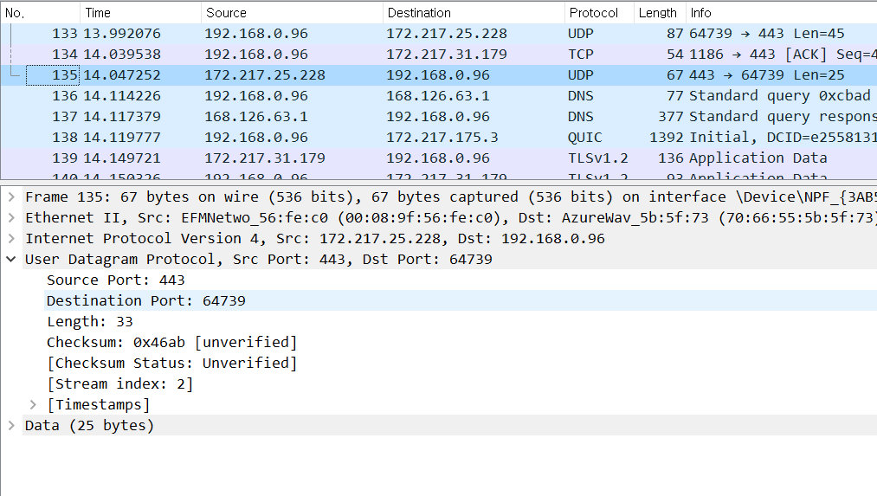
7. Examine a pair of UDP packets. (your host sends the first UDP packet and the second UDP packet is a reply to this first UDP packet.) (Hint: for a second packet to be sent in response to a first packet, the sender of the first packet should be the destination of the second packet). Describe the relationship between the port numbers in the two packets.
(지금까지 봤던 packet이 아닌 서로 pair 표시가 된 UDP packet들을 캡쳐하였음)
second UDP packet(reply packet)
Source port: 443
Destination port: 64739

Slide 14
7. Examine a pair of UDP packets. (your host sends the first UDP packet and the second UDP packet is a reply to this first UDP packet.) (Hint: for a second packet to be sent in response to a first packet, the sender of the first packet should be the destination of the second packet). Describe the relationship between the port numbers in the two packets.
* Describe the relationship between the port numbers in the two packets.
Sended, 전송된 packet의 source port가 reply, 응답한 packe의 destination port가 되고
전송된 packet의 destination port가 응답된 packet의 source port가 되는 관계에 있다.
➔서로 전달되고 그에 대한 응답된 packet이라는 걸 알 수 있다.
First UDP packet(sended packet)
second UDP packet(reply packet)
Source port: 64739
Destination port: 443
Source port: 443
Destination port: 64739
이렇게 보면 두 packet간의 관계가 한눈에 보인다.

Slide 15
Discuss
크게 어려웠던 점은 없었지만 조금 애를 먹었던 것이 4번과 5번 질문입니다.
처음에 전체 크기를 어떻게 잡느냐에 대해 마땅히 큰 생각이 나지 않아 곤경에 처했었는데 UDP segment format설명을 다시 보고 곰곰히 생각해보니 length가 UDP segment 전체 길이를 나타내는 것이라고 설명을 들었으니 그렇다면 전체크기가 이 length field가 표현할 수 있는 정보의 수라는 것을 깨달았고 이를 구해 헤더를 빼면 이제 payload만 남는다는 것을 깨달았습니다.
Source port number도 같은 맥락으로 정확히는 힌트를 보고 4번에서의 생각들을 다시 짚어보니 풀 수 있었습니다.

